Slide 1
COMPUTER ORGANIZATION AND DESIGN
The Hardware/Software Interface
Chapter 1
Computer Abstractions and Technology
Mutah University
Faculty of IT, Department of Software Engineering
Dr. Ra’Fat A. AL-msie’deen
https://sites.google.com/site/ralmsideen/

Slide 2
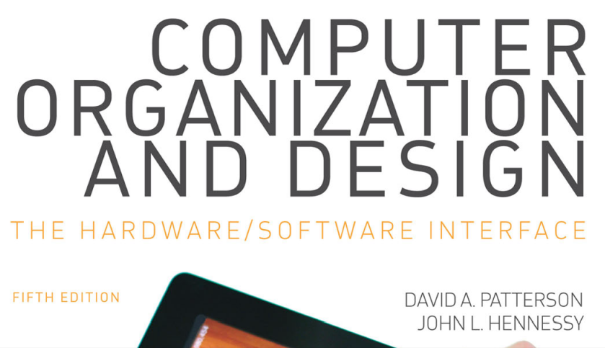
Text Book
This material is based on chapter 1 of

Slide 3
The Computer Revolution
Progress in computer technology
Makes novel applications feasible
  Cell phones
  World Wide Web
  Search Engines
Computers are pervasive

Slide 4
Classes of Computers
Personal computers (PC)
  Delivery of good performance to single users at low cost, a general purpose computer
Servers
  Network based and much larger computers for high capacity, performance, and reliability
  Widest range in cost and capability
Embedded computers
  Hidden as components of a system

Slide 5
The PostPC Era
Personal Mobile Device (PMD)
  Battery operated
  Connects to the Internet
  Hundreds of US dollars
  Smart phones, tablets, electronic glasses
Cloud computing
  Warehouse Scale Computers (WSC)
    Amazon, google, ….
  Software as a Service (SaaS)
    Portion of software run on a PMD and a portion run in the Cloud

Slide 6
What You Will Learn
You can answer the following questions:
  How high-level C/Java programs are translated into the machine language
    And how the hardware executes them
  The hardware/software interface
  What determines the performance of program
    And how it can be improved
  How hardware designers improve performance
  What is parallel processing

Slide 7
Understanding Performance
Algorithm
    Determine number of operations executed
Programming language, compiler, architecture
    Determine number of machine instructions executed per algorithm/operation
Processor and memory system
    Determine how fast instructions are executed
I/O system (including OS)
    Determine how fast I/O operations are executed

Slide 8
Eight Great Ideas in CA
Design for Moore’s Law (1965)
Use abstraction to simplify design
Make the common case fast
Performance via parallelism
Performance via pipelining
Performance via prediction
Hierarchy of memories
Dependability via redundancy

Slide 9








Eight Great Ideas in Computer Architecture

Slide 10
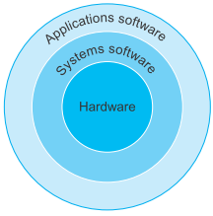
Hierarchy Layers in Programs
Application software
  Written in high-level language
System software
  Compiler:
    Translate HLL code to machine code
  Operating System: service code
    Handling basic input/output
    Managing memory and storage
    Scheduling tasks & sharing resources
Hardware
  Processor, memory, I/O controllers

Slide 11
Levels of Program Code
High-level language
  Level of abstraction closer to problem domain
  Provide for productivity and portability
Assembly language
  Textual representation of instructions
Machine language
  Encoded instructions and data in binary digits (bits)

Slide 12
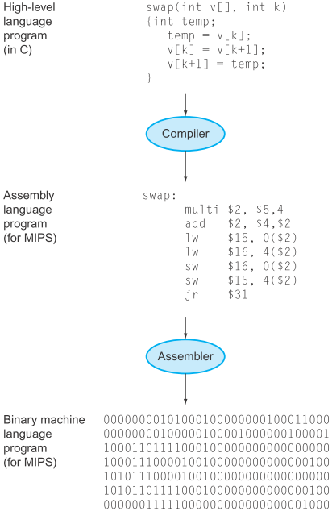
From a High-Level Language to the Language of Hardware
FIGURE x. C program compiled into assembly language and then assembled into binary
machine language.

Slide 13
Components of a Computer
Same components for all kinds of computer
  Inputting/outputting data, processing data, and storing data.
Input/output includes
  User-interface devices
    Display, keyboard, mouse
  Storage devices
    Hard disk, CD/DVD, flash
  Network adapters
    For communicating with other computers

Slide 14
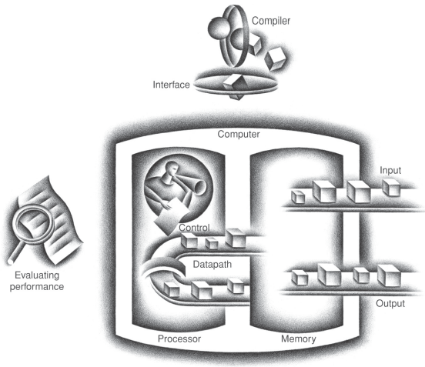
The BIG Picture
FIGURE x. The organization of a computer, showing the ﬁ ve classic components.

Slide 15
Inside the Processor (CPU)
Datapath:
  performs arithmetic operations on data
Control:
  tells datapath, memory, and I/O devices what to do according to the wishes of the instruction
Memory:
  data memory and instruction memory
    DRAM (dynamic random access memory)
Cache memory
  Small fast SRAM (static random access memory) memory for immediate access to data

Slide 16

Abstractions
Abstraction helps us deal with complexity
  Hide lower-level detail
Instruction set architecture (ISA)
  The hardware/software interface
Application binary interface
  The ISA plus system software interface
Implementation
  The details underlying and interface

Slide 17
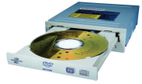
A Safe Place for Data
Volatile main memory
  Loses instructions and data when power off
Non-volatile secondary memory
  Magnetic disk
  Flash memory
  Optical disk (CDROM, DVD)

Slide 18
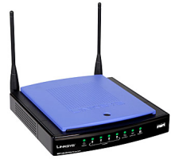
Networks (Communicating with Others)
Communication, resource sharing, nonlocal access
Local area network (LAN): Ethernet
Wide area network (WAN): the Internet
Wireless network: WiFi, Bluetooth

Slide 19
Technology Trends
Electronics technology continues to evolve
  Increased capacity and performance
  Reduced cost

Slide 20
Defining Performance
Which airplane has the best performance?
Response Time and Throughput
  Response time (aka execution time)
    How long it takes to do a task
  Throughput (aka bandwidth)
    Total work done per unit time

Slide 21
Response Time and Throughput
PMDs (personal mobile devices) are more focused on response time, while servers are more focused on throughput.
Example:
  How are response time and throughput affected by
    Replacing the processor with a faster version?
    Adding more processors?
We’ll focus on response time for now…

Slide 22
Multiprocessors
Uniprocessor Performance
Multicore microprocessors
  More than one processor per chip
    integrated circuit Also called a chip. A device combining dozens to millions of transistors.
CPU time
  Time spent by CPU for processing a given job
    Discounts I/O time, other jobs’ shares

Slide 23
Concluding Remarks
Cost/performance is improving
  Due to underlying technology development
Hierarchical layers of abstraction
  In both hardware and software
Instruction set architecture
  The hardware/software interface
Execution time: the best performance measure
Power is a limiting factor
  Use parallelism to improve performance

Slide 24
COMPUTER ORGANIZATION AND DESIGN
The Hardware/Software Interface
Chapter 1
Computer Abstractions and Technology
Mutah University
Faculty of IT, Department of Software Engineering
Dr. Ra’Fat A. AL-msie’deen
https://sites.google.com/site/ralmsideen/

